Slide 1

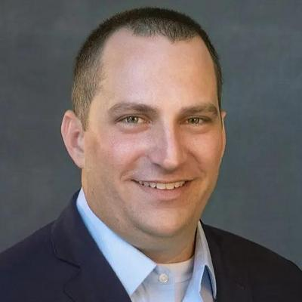

Preparing Your Funeral Home for Sale: Key Considerations
Presented By:
Tony Kumming
President
Rollings and Pinnacle Funeral Service

Slide 2
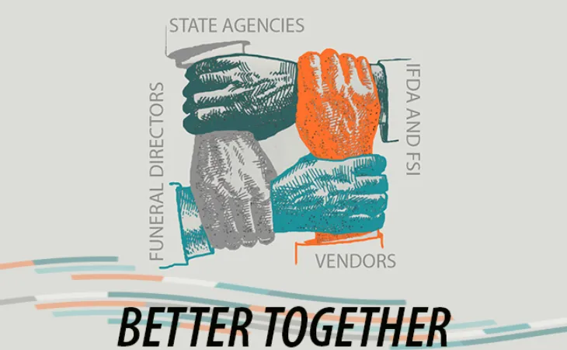
Agenda
Introduction
Should I Sell My Business?
Financial Considerations
Operations After a Sale
Final Tips & Takeaways

Slide 3
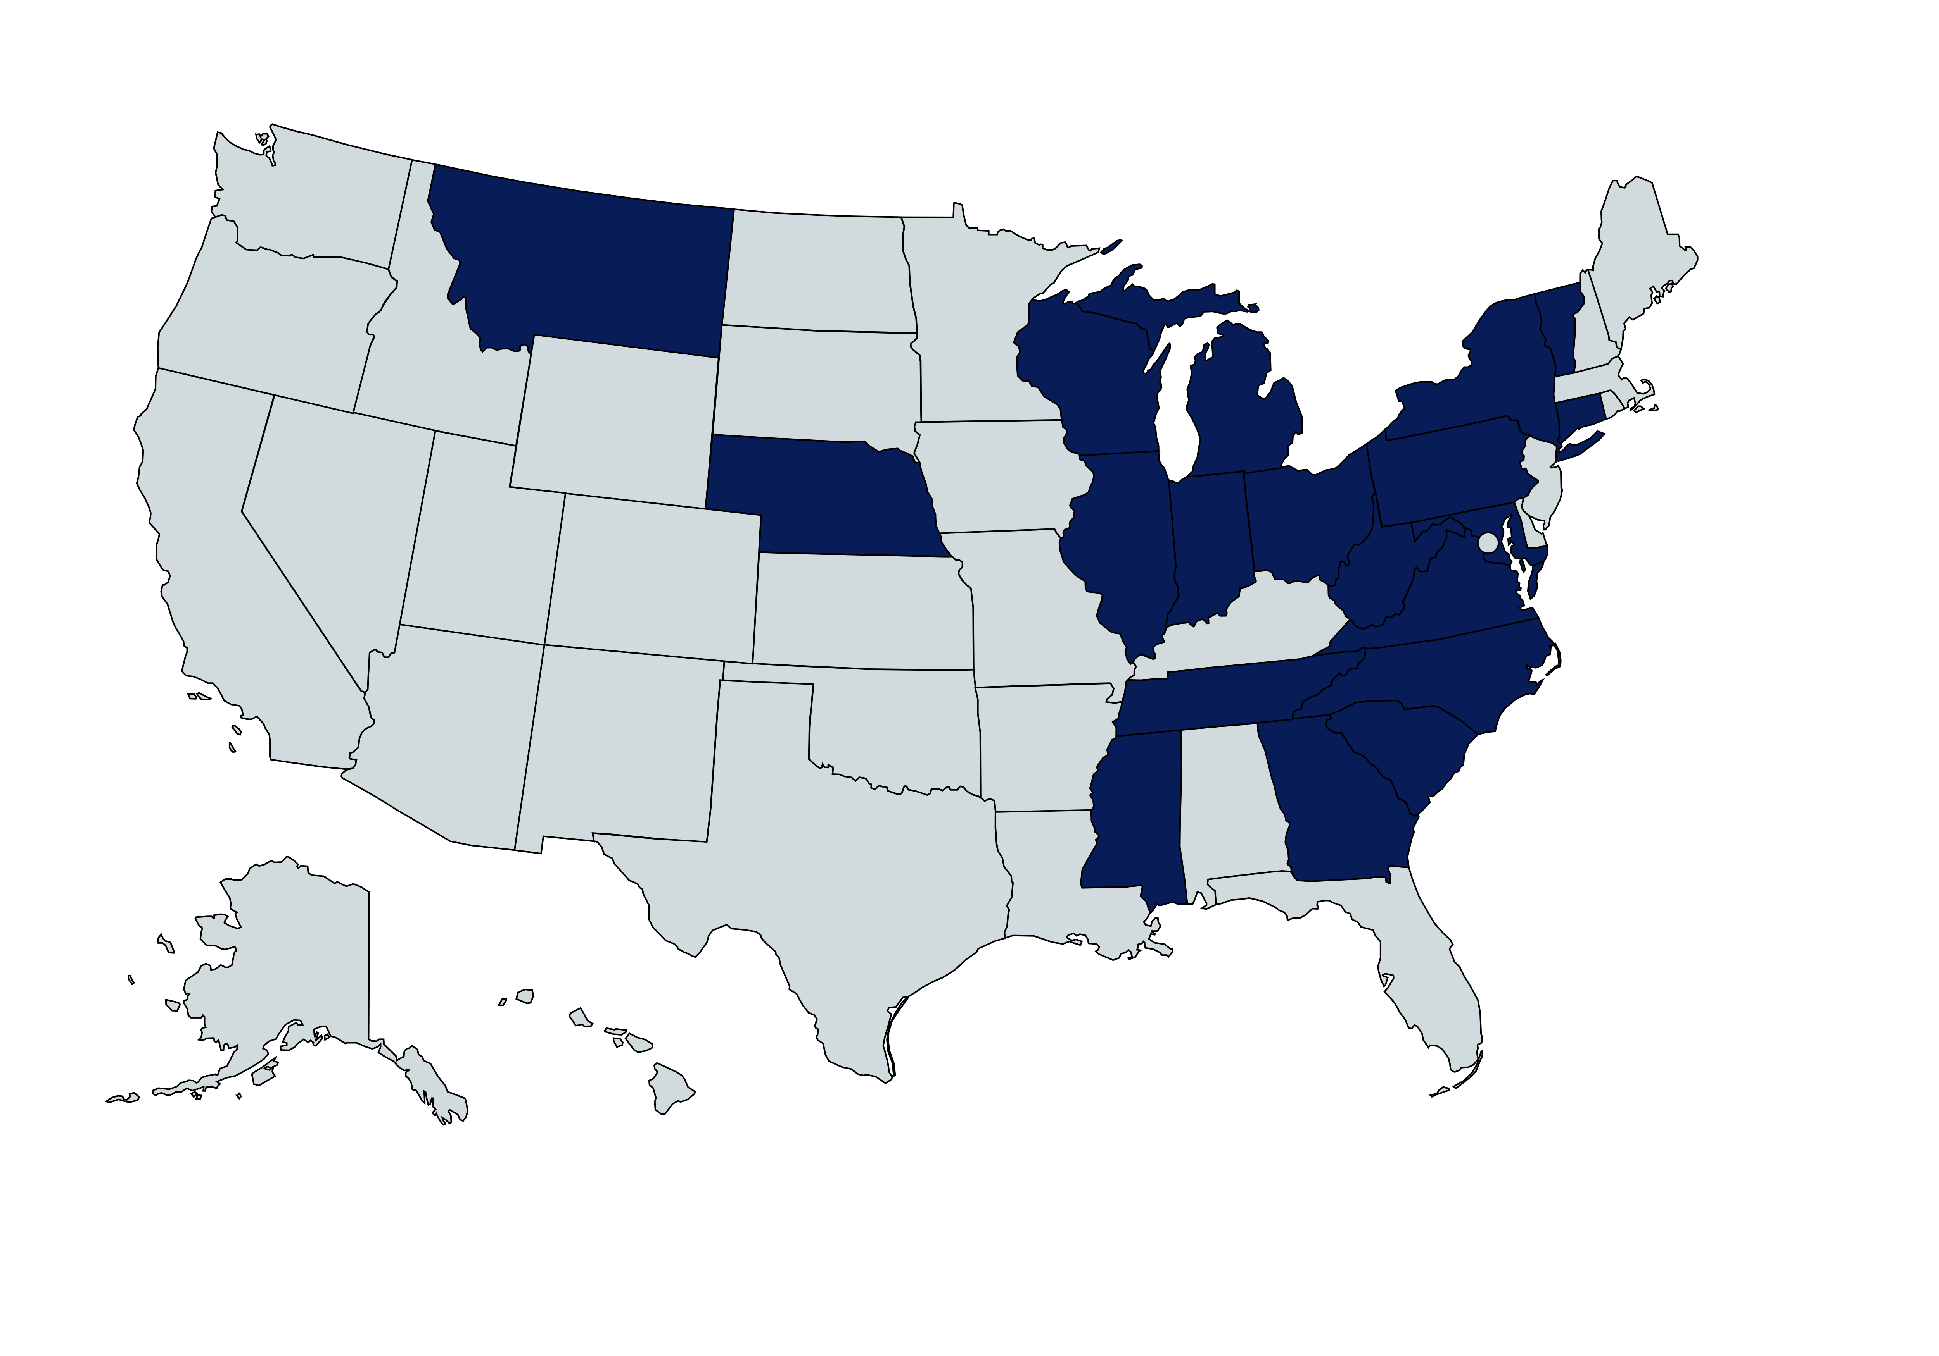
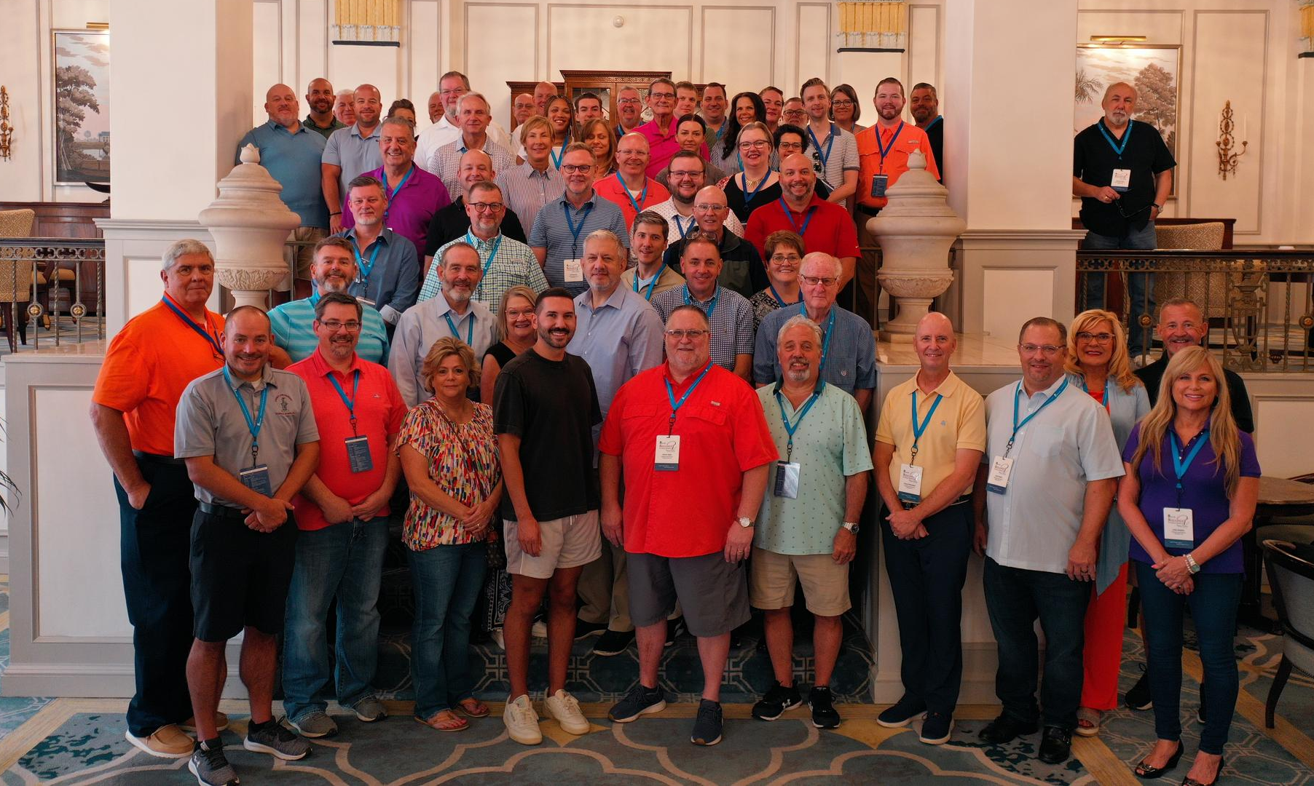
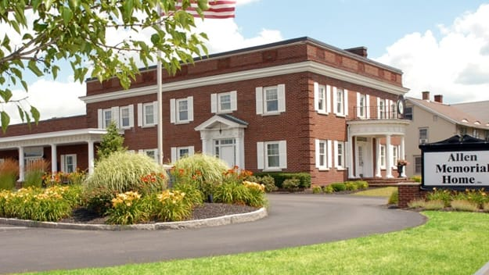
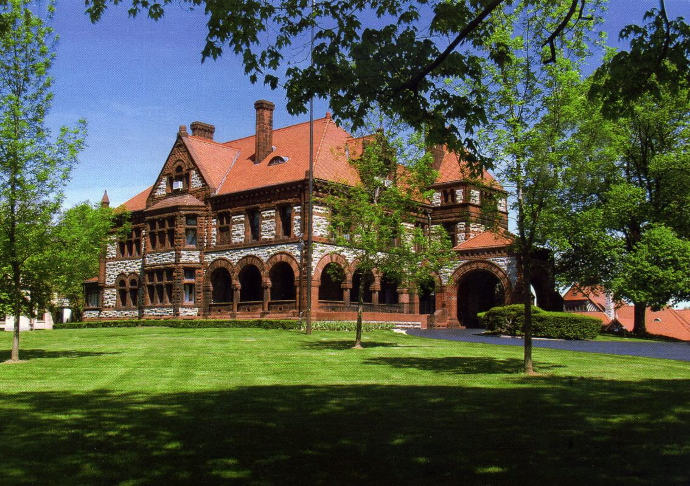
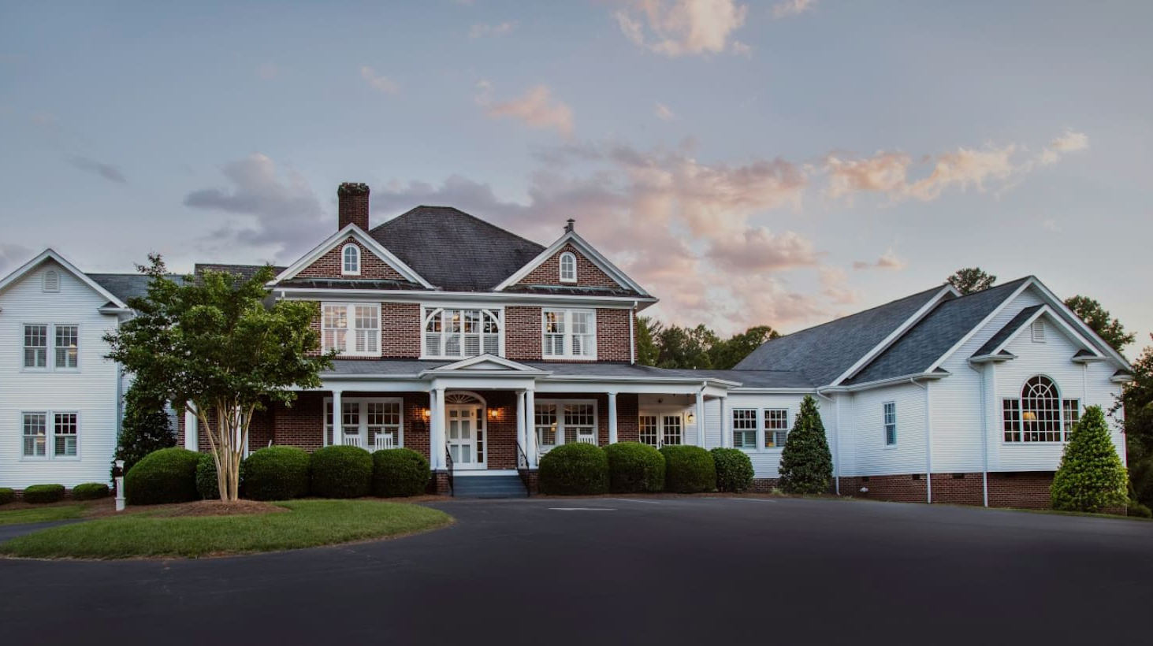
Introduction: Rollings and Pinnacle Funeral Service
Rollings Funeral Service Location Managers
Allen Memorial Home
Endicott, NY
Dunbar Funeral Home
Springfield, OH
Evans Funeral Home
Lenoir, NC

Slide 4
Should I Sell My Business?
Know why you want to sell and what you want your role to be after a sale

Slide 5
Why Should I Sell My Business?
Work Life Balance
Financial Security
Opportunities For You and Your Staff

Slide 6
Financial Considerations
Identify the hidden value and get the best deal structure for your business

Slide 7
Positioning The Business For Maximum Value
Key Considerations
Revenue opportunities
Cost of sales efficiencies
Staffing
Facilities & Vehicles
Advertising
Other considerations
Proforma Example

Slide 8
Positioning The Business For Maximum Value
Key Considerations
Revenue Opportunities
Ancillary offerings
Certified Celebrants
Promoting services
Market considerations

Slide 9
Positioning The Business For Maximum Value
Key Considerations
Cost of Sales Efficiencies
Discount understanding
Reduce inventory

Slide 10
Positioning The Business For Maximum Value
Key Considerations
Staffing Considerations
Training key staff
Part time staff considerations

Slide 11
Positioning The Business For Maximum Value
Key Considerations
Facilities and Vehicles
Merging facilities
Capital expenditures
Economic vehicle considerations
Personal expenses

Slide 12
Positioning The Business For Maximum Value
Key Considerations
Advertising
Return on investment
Approximately 2% of revenue

Slide 13
Positioning The Business For Maximum Value
Key Considerations
Other Considerations
Aftercare
Preneed
Personal expenses

Slide 14
Positioning The Business For Maximum Value
Proforma Example

Slide 15
Getting The Best Deal Structure For You

Slide 16
Operations After a Sale
How will your legacy carry on?

Slide 17
How will a buyer operate your business?
Ongoing input
Conversation during negotiations
Support
Who is buying?

Slide 18
Final Thoughts
And Q&A

Slide 19
Thank you
Tony Kumming
813-579-7048
tony@pinnaclefunerals.com
tonyk@rollingsfuneralservice.com
pinnaclefunerals.com
Rollingsfuneralservice.com

